Slide 1
Smart Road Safety and Driver Health Monitoring System
Team Members: Suriyan L, Arun, Arjun, Roshan, Sairam
24brs1009, 24brs1309, 24brs1232, 24brs1427, 24brs1347

Slide 2
PROBLEM STATEMENT
Poor road conditions like potholes and speed breakers cause accidents.
Low visibility at night, fog, and rain increases risk of collision with humans.
Road damage information is not reported properly to authorities.
Driver health issues during riding can lead to emergencies.
Existing solutions are expensive and not integrated.

Slide 3
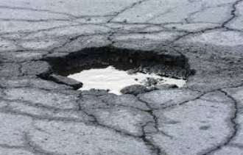
PROJECT OBJECTIVES
Detect potholes and speed breakers using a mobile phone camera and ML model.
Detect humans/obstacles at night using ultrasonic sensors and give alerts.
Map and report bad road conditions using GPS and online services.
Monitor driver health using a pulse oximeter sensor.
Send emergency alerts when abnormal health conditions are detected.

Slide 4
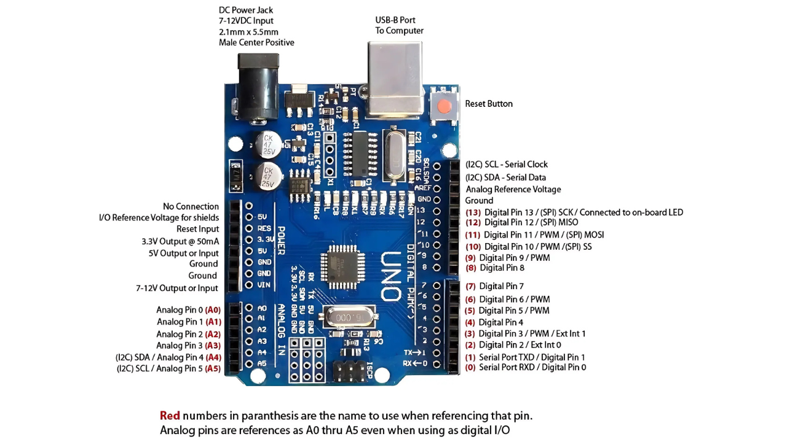
SYSTEM OVERVIEW
The project uses a hybrid approach:
Daytime: Vision‑based detection using smartphone and ML
Nighttime: Sensor‑based detection using Arduino and ESP32
Health Monitoring: Continuous pulse monitoring
Cloud / Alerts: Reporting and notifications

Slide 5
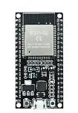
HARDWARE COMPONENTS USED
Arduino Nano
ESP32 Development Board
Ultrasonic Sensor
Pulse Oximeter Sensor
Buzzer
LEDs
Resistors
Capacitors
Jumper Wires
Breadboard
Power Supply (5V / Battery)
Mobile camera, connections

Slide 6
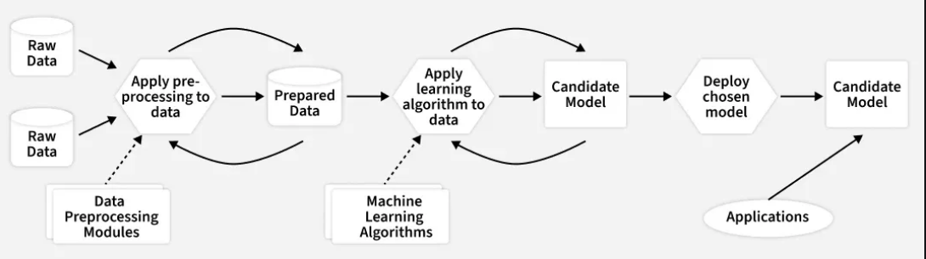
SOFTWARE COMPONENTS USED
Arduino IDE
ESP32 Libraries
Mobile Phone Camera
trained Machine Learning Model
Mobile‑based Server / Edge Processing
Cloud Services (Email / Dashboard / APIs)

Slide 7
DAYTIME WORKING – ROAD DETECTION
Mobile phone mounted on helmet captures road images.
Images are processed using a pre‑trained ML model inside the phone.
The model detects:
Potholes
Speed breakers
Damaged road surfaces
GPS data from the phone is attached to detections.
No external camera hardware is required → low cost.

Slide 8
NIGHT-TIME WORKING – HUMAN DETECTION
Ultrasonic sensor continuously scans the road ahead.
If a human or obstacle is detected within a set distance:
Buzzer sounds
LED alert is activated
Useful during night, fog, and rain, where cameras fail.

Slide 9

HEALTH MONITORING SYSTEM
Pulse oximeter sensor monitors driver’s heart rate.
Sensor data is processed using Arduino.
If pulse rate falls below safe limit:
Emergency alert is triggered
Message is sent to a predefined contact
Health system works independently for reliability.
(may also develop an ML model for this in server)

Slide 10
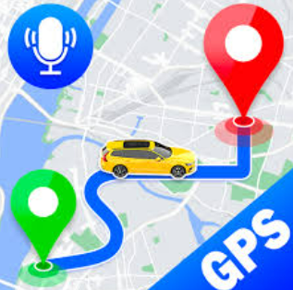
ROAD CONDITION REPORTING
Detected pothole locations are stored with GPS coordinates.
Data is sent to:
Cloud dashboard
Email / notification system
Roads are marked as “Needs Inspection” for authorities.
Multiple detections improve report accuracy.

Slide 11
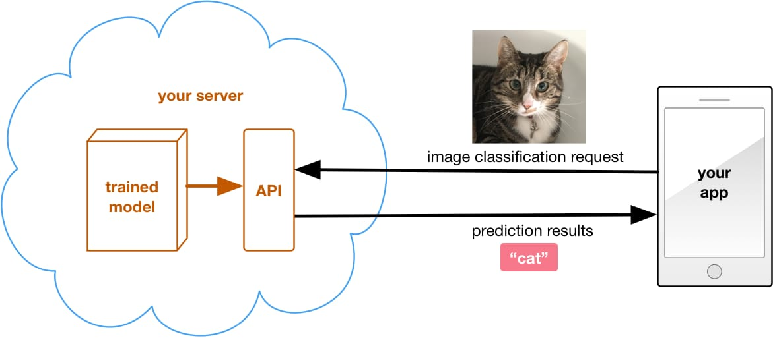
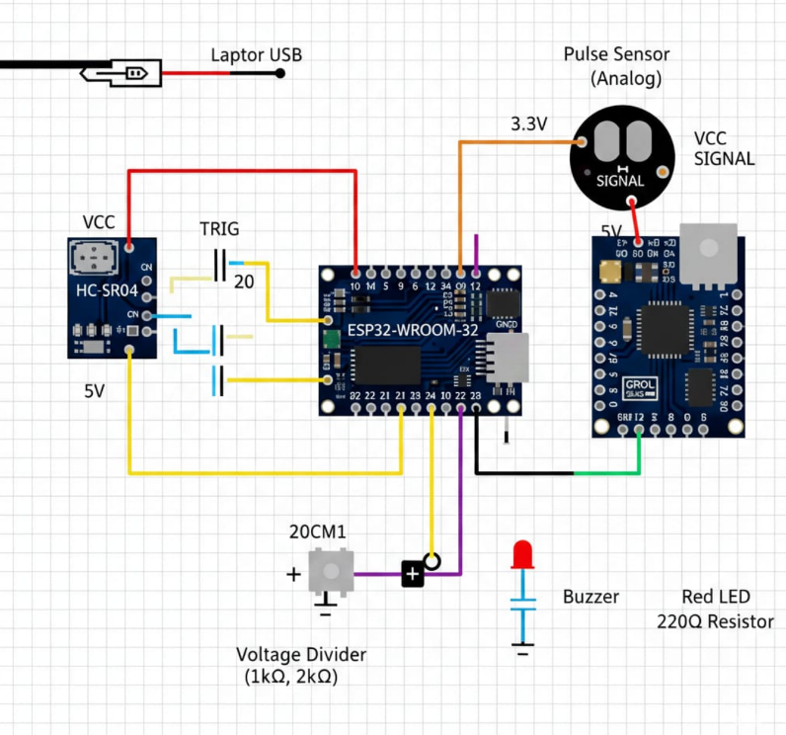
CIRCUIT DIAGRAM
Stored in map based on GPS location
Pothole detected
LED, buzzer or other indicators

Slide 12

PROJECT ROADMAP
Problem identification
Requirement analysis
Hardware selection
Sensor interfacing
Mobile ML integration
Cloud & alert setup
Testing and validation
Final demonstration

Slide 13
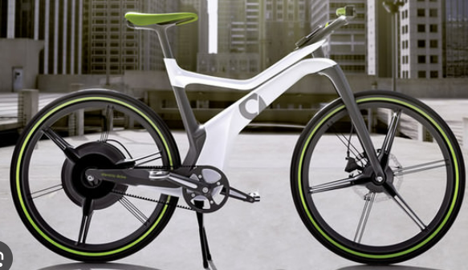
ADVANTAGES
Low‑cost and scalable solution
Uses existing smartphone camera
Works in both day and night conditions
Improves road safety and driver health
Supports smart city initiatives

Slide 14
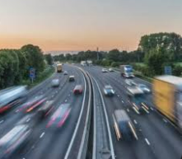
APPLICATIONS
Two‑wheeler and car safety systems
Smart city road monitoring
Accident prevention systems
Driver health safety devices
Road maintenance planning

Slide 15

FUTURE SCOPE
Real‑time Google Maps integration
AI‑based severity classification
Automatic emergency services alert
Large‑scale crowd‑sourced road monitoring

Slide 16
THANK YOU

